Slide 1
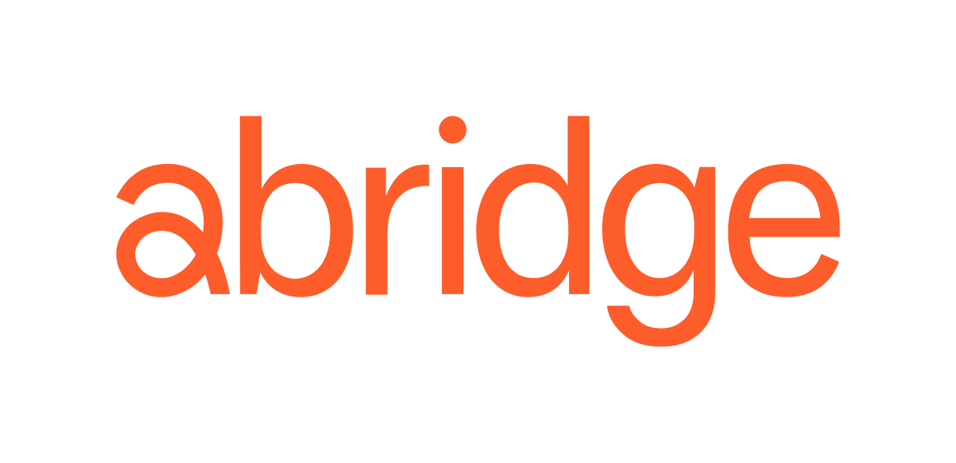

Slide 2
Healthcare systems are under water right now.
Okay maybe it pulls a few, but only in the subtext.
Confidential and Proprietary - [ACMS]

Slide 3
Margins are under attack
2022 was the worst financial year on record for hospitals.
Category | Expense growth per adjusted discharge (Jan 2019-Jan 2022) | Cost Increase Drivers
Labor | 19% | Burnout, salary inflation, labor shortages
Supply Chain | 21% | Global supply chain risks and price inflation
Prescription Drugs | 37% | Pharmaceutical company price increases and new-to-market drugs
Non-Operating Expenses | 20% | IT and facility-related expenses necessary for providers to remain competitive
Source: Advisory Board 2022 Health Care Industry Trends
Confidential and Proprietary - [ACMS]
Notes:
Workplace shortage is 1; finance is 2; script has been flipped;
Look at what happened in 2.5y;
2022 was the worst year in non for profit systems; 60% of nonprofit systems are hitting one of their bond covenants;
For non profits, 2020-2023 the % of revenue that labor reps has gone up by three percent; thats teh story of productivity; YOU HAVE TO MAKE UP FOR HAT SOMEWHER ELSEP
Productivity not thru a widget; ITS ITH THE WORKFORCE; teh widgets ive experienced over the last 10 y IS NOT GOING TO WORK;
THIS IS A PLATFORM; THIS IS NOT A WIDGET;

Slide 4
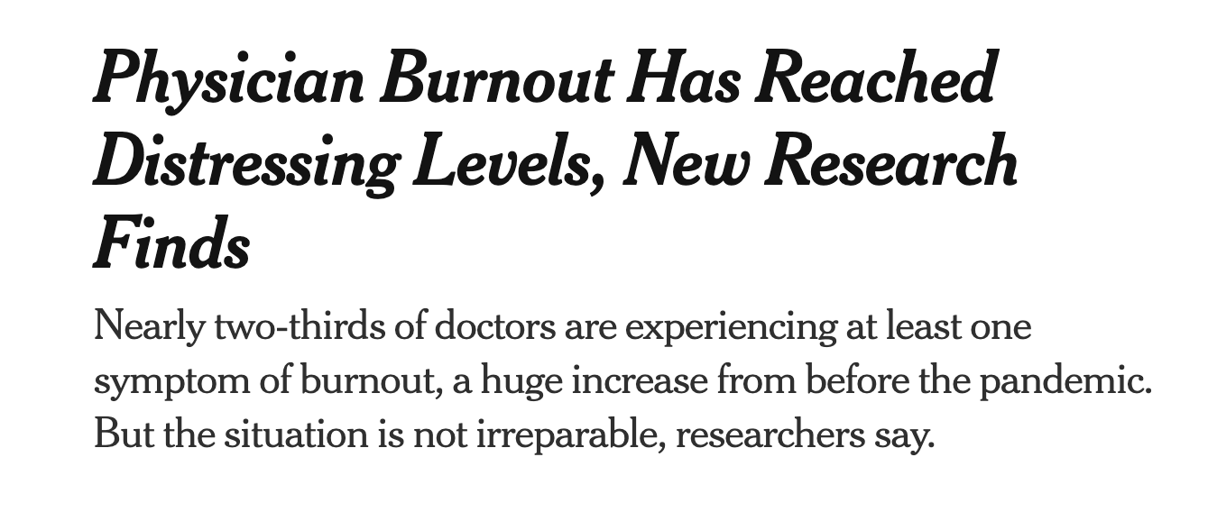
Burnout is the #1 concern for hospital CEOs
NY Times - September 29, 2022
Becker’s - March 24, 2023
Confidential and Proprietary - [ACMS]
Notes:
Because labor force out of cotno
What is foremost in the minds of execs at a system like UPMC; 1-10 worfoplace shortage

Slide 5
… and clerical burden is the largest contributor
Doctors spend 49% of their time documenting in the EHR, and increased clerical burden is the leading cause of burnout.
Increased clerical burden
62%
Increased productivity requirements / expectations
51%
A untenable payment / reimbursement model
21%
Erosion of professionalism
21%
Excessive metrics
18%
Excessive work hours
11%
Confidential and Proprietary - [ACMS]
Notes:
Clinical documentation is the leading cause of burnout, resulting in partial notes that don’t capture the whole story.
Nearly ⅔ of all doctors are experiencing one symptom of burnout, contributing to inaccurate billing and coding.

Slide 6
Abridge is the only solution positioned to tackle the scope of this opportunity.
Confidential and Proprietary - [ACMS]
Notes:
Clinical documentation is the leading cause of burnout, resulting in partial notes that don’t capture the whole story.
Nearly ⅔ of all doctors are experiencing one symptom of burnout, contributing to inaccurate billing and coding.

Slide 7
About Abridge
We are a team of clinicians, creatives, and computer scientists with deep healthcare experience across both clinical settings and digital health.
We structure and summarize medical conversations using best-in-class AI, based on a training dataset of >4M annotations.
With deep computer science DNA from Carnegie Mellon University, we have published more peer reviewed papers on these topics than any other entity .
Confidential and Proprietary - [ACMS]
Notes:
Clinical documentation is the leading cause of burnout, resulting in partial notes that don’t capture the whole story.
Nearly ⅔ of all doctors are experiencing one symptom of burnout, contributing to inaccurate billing and coding.

Slide 8
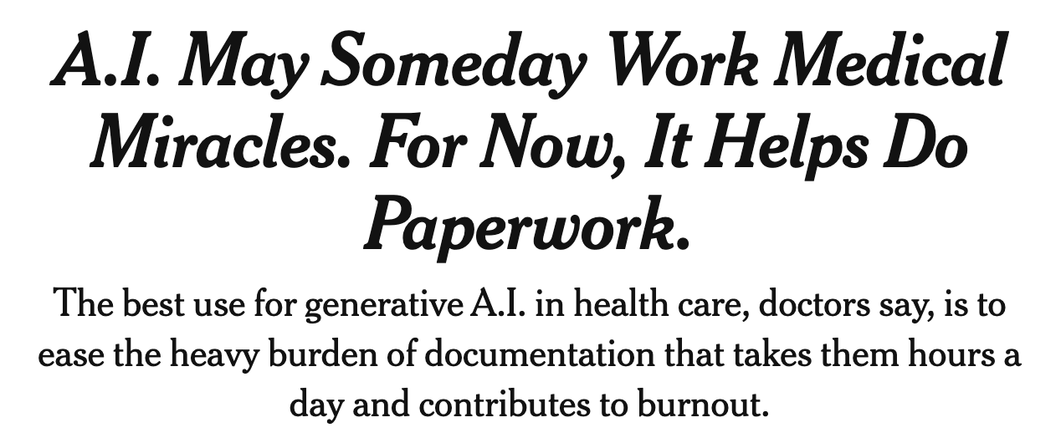
As seen in the media
Confidential and Proprietary - [ACMS]
Notes:
Last bullet, separate them out;
Scienceis the easiest thing to buy intio; what we need is a solution;

Slide 9
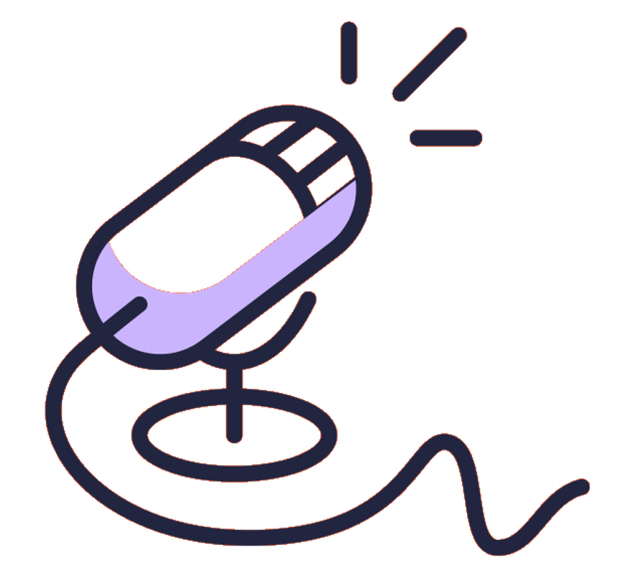
Abridge’s technology creates value for clinicians, patients, and enterprises
Go from one conversation to…
Clinical Documentation
Patient-Facing Summaries
Coding & Clinical Documentation Improvement
Confidential and Proprietary - [ACMS]
Notes:
Clinical documentation is the leading cause of burnout, resulting in partial notes that don’t capture the whole story.
Nearly ⅔ of all doctors are experiencing one symptom of burnout, contributing to inaccurate billing and coding.

Slide 10
Abridge fits within existing workflows and seamlessly integrates to the EHR
EHR
Confidential and Proprietary - [ACMS]

Slide 11
Let’s do some improv…
Confidential and Proprietary - [ACMS]
Notes:
Last bullet, separate them out;
Scienceis the easiest thing to buy intio; what we need is a solution;

Slide 12
Abridge is loved by physicians and saves up to 2 hours a day per doctor
Joy in Medicine
Rapid Iteration
Long Conversations
“WOW… first case done. This is as big a deal as the stethoscope!”
“[It’s great to see how] Monday's Abridge is different than Tuesday's is different than Wednesday’s than Today's."
“Zero edits needed.”
Speed!
Speed!
Speed!
“This is so fast, and at the end of my clinic I can just go home.”
“Turnaround speed is great! Morning clinic done, all notes signed with 7 new patients seen! Would still be waiting another 2-3 hours for my last couple DAX dictations.”
“It has truly decreased my charting time along with increasing the amount of information in my notes.”
Confidential and Proprietary - [ACMS]

Slide 13
Key benefits of Abridge’s generative AI solution
Deeply integrates with key workflows and existing systems
Auditable, evidence-based AI-generated output
Clinician-led such that there is a deep understanding of user needs
The technology supports patient-centered use cases
The technology is 100% AI-powered
Confidential and Proprietary - [ACMS]
Notes:
Last bullet, separate them out;
Scienceis the easiest thing to buy intio; what we need is a solution;

Slide 14
Interested in documenting “The Abridge Way”?
Complete this survey for a 14 day free trial.
Questions?
shiv@abridge.com + lindsey@abridge.com

